Slide 1
GWu BUSINESS ANALYTICS Practicum Office of Program planning, Analysis and Evaluation

Slide 2
NIGMS Practicum 4:
Mapping Collaborations across Fields

Slide 3
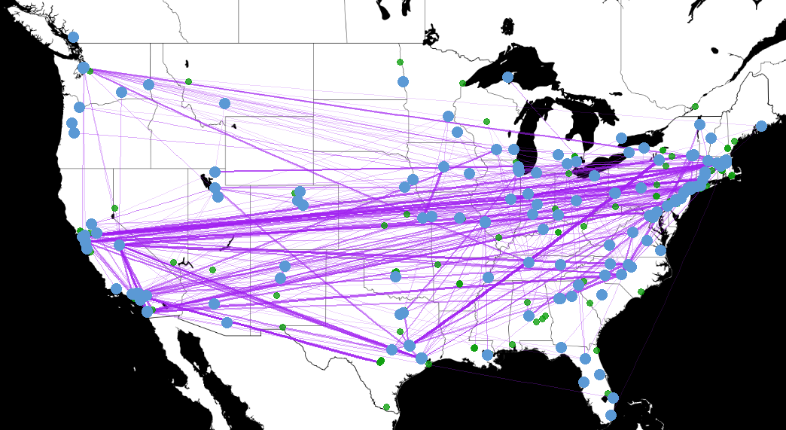
Background
NIGMS supports a wide network of researchers across the United States
Collaboration is an important aspect of scientific research
Many of these researchers collaborate with other researchers, often from different places and fields
• NIGMS grant locations represented by blue dots
• Collaborating grant locations represented by green dots
― Collaborations on publications represented by grey lines

Slide 4
Rationale
Understanding collaborative networks can help us understand how researchers interact with one another
Gaps in collaborative networks may represent an opportunity for scientific progress via interdisciplinary work
Network analysis can reveal non-grantee researchers who are performing key work relevant to our Institute
Expanding Co-authorship Network for a Set of NIGMS Grantees

Slide 5
Scope
Study Group
Researchers continually supported by NIGMS from 2001-2015 (~450 investigators)
Federal support for researchers
Publications
Comparison Group
Researchers continually supported by NIH from 2001-2015 (~500 investigators)
Federal support for researchers
Publications
Level of NIGMS support varies

Slide 6
Scope
Study Questions
Do NIGMS-supported researchers collaborate more often with other NIGMS-supported researchers?
Does the type of grant awarded influence collaboration behavior?
Does variety in funding sources influence collaboration behavior?
Does the scientific discipline influence collaboration behavior?

Slide 7
Datasets Available
Public Grants Databases (NIH / Federal RePORTER)
Contains data about funding histories and some outputs of grants
https://projectreporter.nih.gov/reporter.cfm
https://exporter.nih.gov/
https://federalreporter.nih.gov/
Web of Science – Core Collection
Has publication information as well as metadata for additional linkages (citations, authorships, etc.)
Scopus - https://www.scopus.com/home.uri
Database of publications with unique author IDs

Slide 8
Skills Development and Approaches
Data Mining
Extracting large amounts of grants / publication from websites
Network Analysis
Science of Science software - https://sci2.cns.iu.edu/user/index.php
Co-authorship, Co-citation ,Other bibliometric measures
Data Visualization
Gephi - https://gephi.org/

